Slide 1

ActivMoney Analysis Impact on SA, Deposits and Simulations
Sep 2023

Slide 2
Agenda
Portfolio cuts and reports
ETB impact on SA
NTB impact on SA
Did switching off Activmoney help in SA
Simulations

Slide 3
ETB
FKYC Base (Acq Pre Apr’23) 1.74 Cr
Subscribers
1.87 Lakhs (1.1%)
Sweep Outs
35K (19%)
~1.1% ETB base have subscribed to ActivMoney of which 19% of them have funds swept out;
as expected, this is more prominent towards High AMB vs Low segment
Notes:
A/B

Slide 4
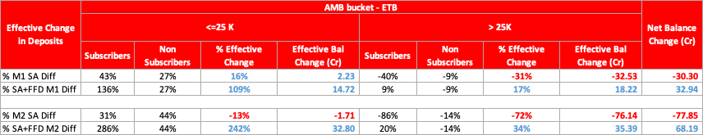
ETB Impact on SA
Post subscription, we have effectively Lost 30 Cr SA by M1 and 78 Cr SA by M2; However, gained 33 Cr and 68 Cr in SA + FFD Balances by M1 & M2 respectively
Notes:
A/B

Slide 5
NTB Impact on SA
Post subscription, we have effectively Lost 1 Cr SA by M1 and 18 Cr SA Balance by M2 compared to non subscribers; However, gained 13 Cr and 27 Cr in SA + FFD Balances by M1 & M2 respectively
Notes:
A/B

Slide 6
Conclusion :
In ETB, there has been consistent depletion of SA and although SA +FFD balance is going up,
it is not significant enough to make up for the depleted SA
In NTB , there has been depletion in SA for sure, but it does bring good balances in FFD compared to non subscribers.
Notes:
A/B

Slide 7
Switching off Activmoney for NTB has helped in improving SA
5% increment in SA ATS was observed in NTB base for August 25-31 FKYC base where activmoney consent was switched off – compared to same week FKYC last month

Slide 8


Slide 9
NTB
Acquisitions (Jun-till date’23) 15.5 lakh
Subscribers
6.5 Lakhs (42%)
Sweep Outs
39.8 K (6%)
~42% NTB base have subscribed to ActivMoney of which 6% of them have funds swept out;
Notes:
A/B

